Slide 1
Weather Prediction in KSA
Majed Alghamdi
Presented by
Eman Albarakah
Rashed Alsumaydi
T5 DATA SCIENCE BOOTCAMP
5 Dec 2021

Slide 2
Outlines
Introduction
01
Model
05
Workflow
02
Tools
06
Dataset
03
EDA
04
Conclusion
07

Slide 3
Introduction
Weather is an important aspect of our life as it can help us to know the expected temperature.
Goal:
Is to predict what the weather will be like in Saudi Arabia and what are the changes.
21°C 15°C | 24°C 21°C | 23°C 19°C | 21°C 18°C | 19°C 14°C | 20°C 17°C | 18°C 16°C

Slide 4
Timeline & workflow
Wednesady
Saturday
Monday
Tuesday
Wednesday
Nov 24
Nov 27
Nov 29
Nov 30
Dec 1
EDA & Data Cleaning
@hack
Choose Dataset
Building & Testing Models
Visualisation

Slide 5
Dataset
Kaggle
Over 250k climate records with 12 features
From 2017 until 2019
City
Weather
Wind
Humidity
Barometer
Time
Date
Year
Month
DAY

Slide 6
Data Cleaning
NaN Values
Reomving columns:
Found in:
Wind
Humidity
Barometer
Filled with mean in each column
Date
Time
Weather Conditions
NaN Values & Outliers
Unnecessary columns
Outliers
Before:
15 columns
After:
12 columns
Dropped from:
Humidity
Wind
Barometer

Slide 7
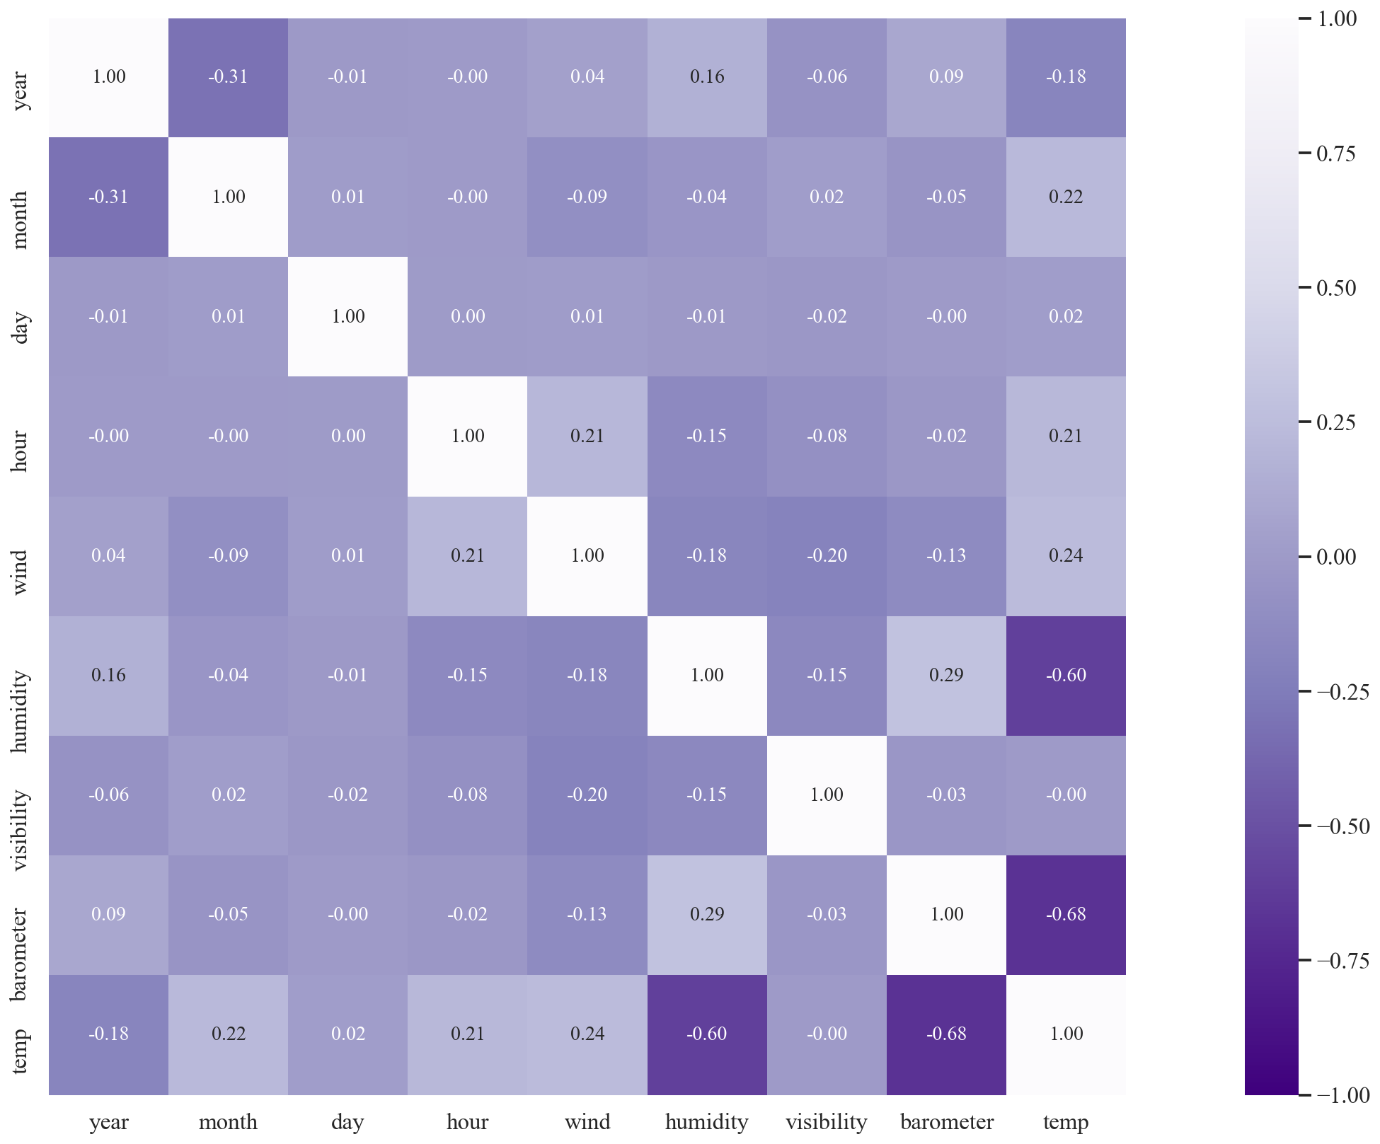
EDA Analysis
Most important features in the data
Barometer & Humidity are best considered in relation to temperature.

Slide 8
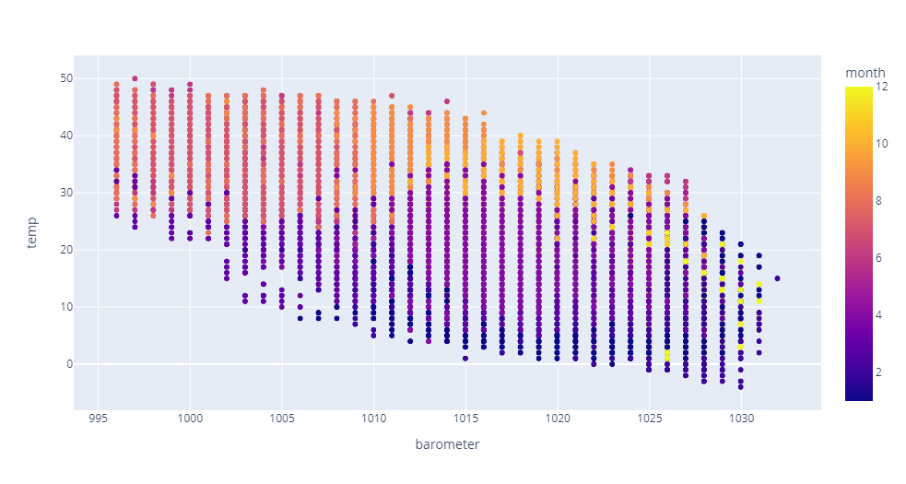
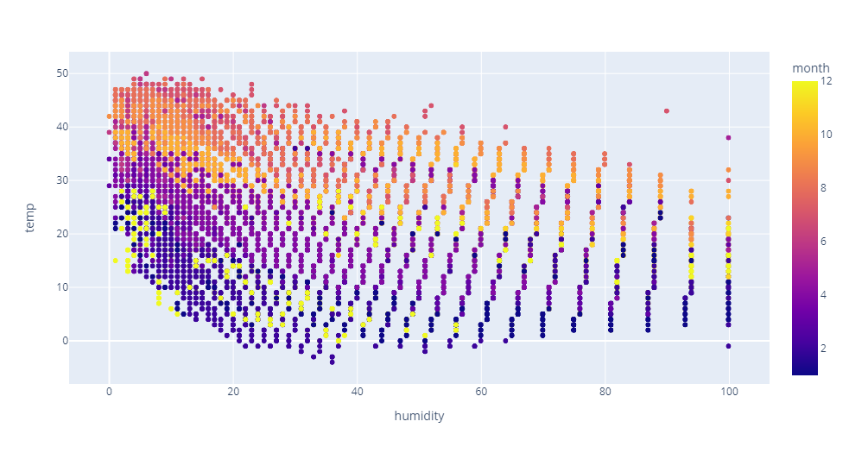

Slide 9
Weather Changes in 2017-2019
There was a change of temperature every year where maximum and minimum temperatures decreases and increases, respectively.
Year | Maximum Temperature
2017 | 50
2018 | 48
2019 | 45
Year | Minimum Temperature
2017 | -4
2018 | 1
2019 | 1

Slide 10
Barometer influences in mountain cities
Temperature barometer
Assir & Baha doesn't get as cold as Jawf for example.

Slide 11
Model Selection & Scores
Model | Validation Score | Test Score
Linear Regression | 78% | 78%
Ridge Regression | 78% | 78%
Polynomial Regression | 98.4% | 98.4%
Random Forest Regressor | 98.1% | 98.2%
Decision Tree Regressor | 96.1% | 96.2%
Support Vector Regressor (SVR) | 93% | 92.2%

Slide 12





Tools

Slide 13
Conclusion
Acuuracy
98%
Random Forest Regression
Precision
Error
Helping people find expected weather
Weather Aplications

